Slide 1

Data Science Naïve Bayes
Facultad de Ciencias Económicas
Catedrático: Franz Haidacher

Slide 2
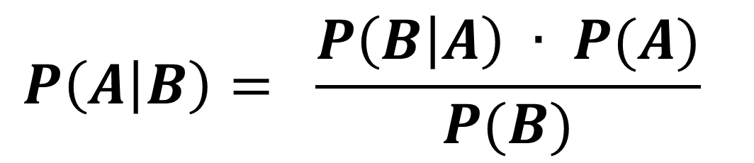
Bayes Theorem
$$P\left(A | B\right)= \frac{P\left(B | A\right) ∙ P(A)}{P(B)}$$

Slide 3
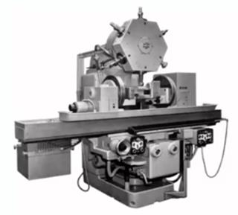

Naïve Bayes Intuition
Two machines produce the same tools
A
30 per hour
B
20 per hour

Slide 4
Naïve Bayes Intuition
Two machines produce the same tools
A
30 per hour
P(A) = 30/50 = 0.6
B
20 per hour
P(B) = 20/50 = 0.4

Slide 5
Naïve Bayes Intuition
A
1% defective overall
B

Slide 6
Naïve Bayes Intuition
A
1% defective overall
B
P(defect) = 1% = 0.01

Slide 7
Naïve Bayes Intuition
50% of defectives from A
A
B
50% of defectives from B

Slide 8
Naïve Bayes Intuition
50% of defectives from A
A
P(A | defect) = 50% = 0.5
P(B | defect) = 50% = 0.5
B
50% of defectives from B

Slide 9
Naïve Bayes Intuition
What is the probability that tool from machine B is defective?
B
50% of defectives from B

Slide 10
Naïve Bayes Intuition
What is the probability that tool from machine B is defective?
P(defect | B) = ?
B
50% of defectives from B

Slide 11
Naïve Bayes Intuition
P(B|defect) * P(defect)
P(defect | B) =
P(B)
B

Slide 12
Naïve Bayes Intuition
0.5 * 0.01
P(defect | B) =
0.4
B

Slide 13
Naïve Bayes Intuition
P(defect | B) =
0.0125
B

Slide 14
Naïve Bayes Intuition
P(B|defect) * P(defect)
P(defect | B) =
= 1.25%
P(B)
Example:
10,000 tools
4,000 from machine B
100 defective (1%)
50 defective from B (50%)

Slide 15
Naïve Bayes Intuition
P(B|defect) * P(defect)
P(defect | B) =
= 1.25%
P(B)
Example:
10,000 tools
4,000 from machine B
100 defective (1%)
50 defective from B (50%)
% defective from B = 50 / 4,000 = 1.25%

Slide 16
Naïve Bayes Intuition
P(A|defect) * P(defect)
P(defect | A) =
P(A)
0.5 * 0.01
=
= 0.83%
0.6
Example:
10,000 tools
6,000 from machine A
100 defective (1%)
50 defective from A (50%)
% defective from A = 50 / 6,000 = 0.83%

Slide 17
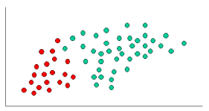
Naïve Bayes Intuition
Salary
Drives
Walks
Age

Slide 18
Naïve Bayes Intuition
Salary
New data point
Drives
o
Walks
Age
How should we classify this new point?

Slide 19
Naïve Bayes Intuition
Salary
New data point
Drives
o
Walks
Age
P(X|walks) * P(walks)
P(walks | X) =
P(X)

Slide 20
Naïve Bayes Intuition
posterior probability
likelihood
prior probability
P(X|walks) * P(walks)
P(walks | X) =
P(X)
marginal likelihood

Slide 21
Naïve Bayes Intuition
posterior probability
likelihood
prior probability
P(X|drives) * P(drives)
P(drives | X) =
P(X)
marginal likelihood
posterior probability
likelihood
prior probability
P(X|walks) * P(walks)
P(walks | X) =
P(X)
marginal likelihood

Slide 22
Prior Probability
Salary
Drives
(40)
Walks
(20)
Age
Number of walkers
20
P(walks) =
=
= 0.333
Total observations
60

Slide 23
Marginal Likelihood
Salary
Drives
o
Walks
Age

Slide 24
Marginal Likelihood
Salary
similar features
Drives
Walks
Age

Slide 25
Marginal Likelihood
Salary
similar features
Drives
(40)
Walks
(20)
Age
Number of similar observations
3
P(X) =
=
= 0.05
Total observations
60

Slide 26
Likelihood
Salary
similar features
Drives
(40)
Walks
(20)
Age
Number of similar observations among those who walk
1
P(X|walks) =
=
= 0.05
Total number of walkers
20

Slide 27
Posterior Probability
Salary
similar features
Drives
(40)
o
Walks
(20)
Age
P(X|walks) * P(walks)
P(walks | X) =
P(X)

Slide 28
Posterior Probability
Salary
similar features
Drives
(40)
o
Walks
(20)
Age
0.05 * 0.333
P(walks | X) =
= 0.333
0.05

Slide 29
Posterior Probability
Salary
similar features
Drives
(40)
o
Walks
(20)
Age
0.05 * 0.666
P(drives | X) =
= 0.666
0.05

Slide 30
Posterior Probability
Salary
similar features
Drives
(40)
o
Walks
(20)
Age
P(drives | X) > P(walks | X)
0.666
0.333

Slide 31
Posterior Probability
New point is a driver
Salary
Drives
(40)
Walks
(20)
Age
P(drives | X) > P(walks | X)
0.666
0.333

Slide 32
Posterior Probability
P(X|drives) * P(drives)
P(X|walks) * P(walks)
>
P(X)
P(X)
P(drives | X) > P(walks | X)
0.666
0.333

Slide 33
Posterior Probability
P(X|drives) * P(drives)
>
P(X|walks) * P(walks)
P(drives | X) > P(walks | X)
0.666
0.333

Slide 34
Posterior Probability
0.666 + 0.333 = 1
P(drives | X) > P(walks | X)
0.666
0.333

